Slide 1

Overview for Care Continuum Facilities
Personalized Care. Reduced Readmissions. Enhanced Senior Well-being.

Slide 2
Care Continuum Facilities Seek Creative Ways to Reduce Readmission and Improve Patient Outcomes
Approx. 99%
Of nursing homes and 96% of assisted living facilities are experiencing severe staff shortages
Approx. 60%
Of patients receiving home care had a lower risk of readmission after 30 days compared to those discharged directly to home
OVER $26B
The cost of readmissions to medicare annually, with $17 billion of that being potentially preventable

Slide 3
Benefits for Facilities such as Hospitals & Assisted Living
Partner with Our Agency, Powered by Sensi’s Care Intelligence Technology
Reduce Readmissions: Sensi’s proactive assessment detects early issues, preventing readmissions and improving outcomes.
Personalized Care: Sensi matches patients with the best caregiver for tailored, exceptional care.
Enhanced Well-being: Sensi provides a 360-degree view of physical, emotional, and cognitive needs, promoting well-being.

Slide 4
Independent Living Facilities Seek Creative Ways to Increase Visibility Into Residents’ Care Needs
Approx. 90%
Prefer to stay in their independent living settings rather than move to more intensive care environments like assisted living or nursing homes
Approx. 70%
Around 70% of independent living facilities in the U.S. do not have 24/7 on-site medical staff, relying instead on external services
OVER
80%
Of seniors in independent living have at least one chronic condition, and 68% have two or more, often requiring regular care management

Slide 5
Benefits for Independent Living Facilities
Partner with Our Agency, Powered by Sensi’s Care Intelligence Technology
Preserve Independence: Sensi helps residents stay independent longer, delaying the need for assisted living.
Enhanced Support: Sensi’s 360-degree assessment addresses health needs proactively, compensating for limited on-site staff.
Improved Visibility: Sensi offers continuous insights into care needs, enabling timely interventions and better management.

Slide 6

Meet Sensi
24/7 Care Co-Pilot - Standard of Care
Early Detection => Proactive Care
We have partnered with Sensi’s HIPAA-compliant technology to provide a 360-degree understanding of seniors’ physical, emotional, and cognitive needs.
It’s a must-have technology for independent living , assisted living, hospitals, and PACE facilities to provide holistic care at scale.
24/7
Care Copilot
Personalized Care
Reduced Hospitalizations
Enhanced Senior Well-being

Slide 7
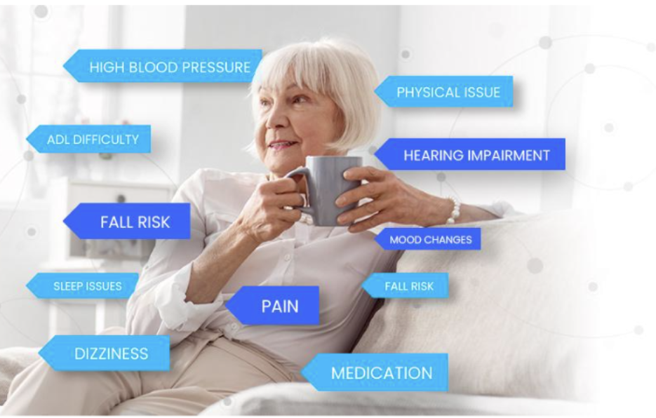

Gain Edge with Data-Backed Intelligence
Your Patients/Residents Experience Proactive Care
Always-on virtual care assessment through 100% audio technology via a plug and play device, requiring no human engagement.

Slide 8
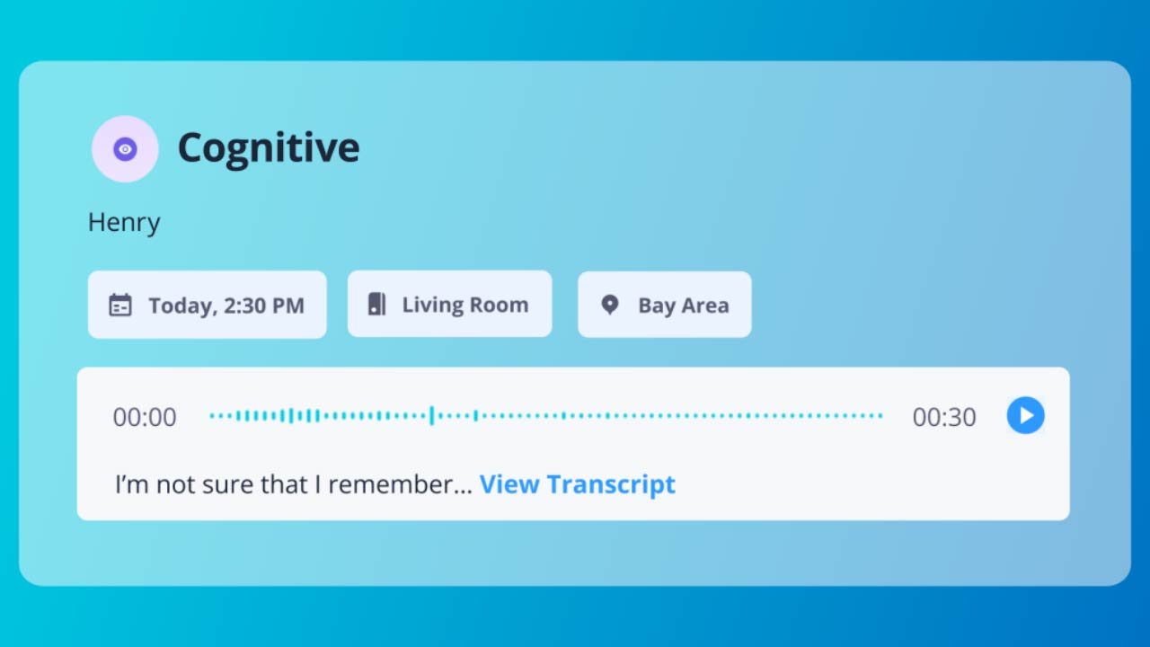
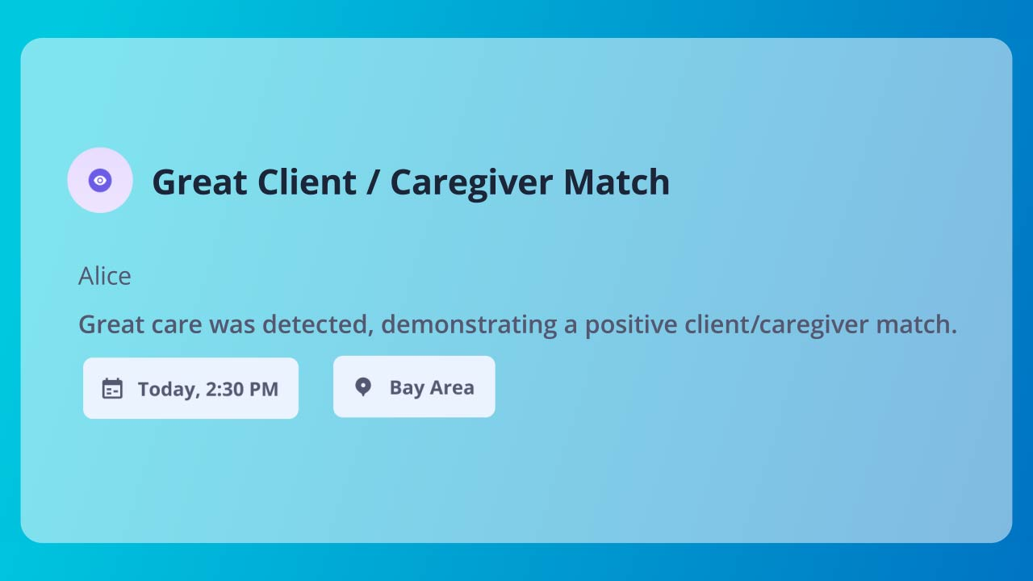
Personalized Care Plan
Timely Intervention => Higher Satisfaction Among Patients/Residents
Sophisticated intelligence to capture holistic care signals to detect or predict physical, emotional, and cognitive issues (e.g., early signs of pneumonia, UTIs, care resistance, cognitive changes, and emergency events such as falls)
Patients matched with best caregiver expertise to offer exceptional personalized care

Slide 9
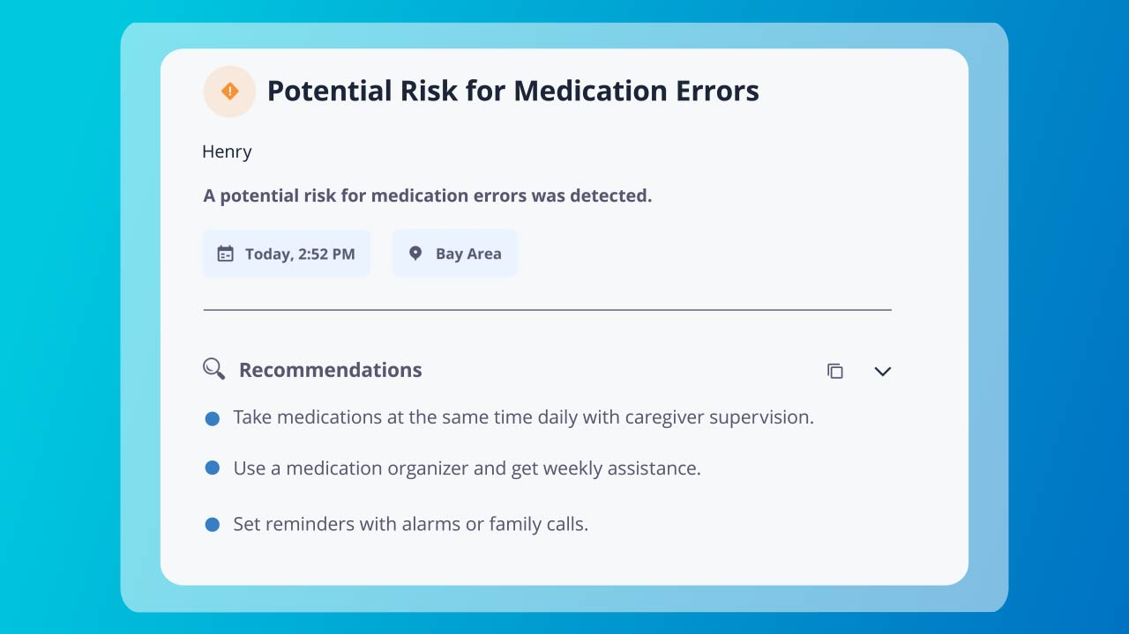
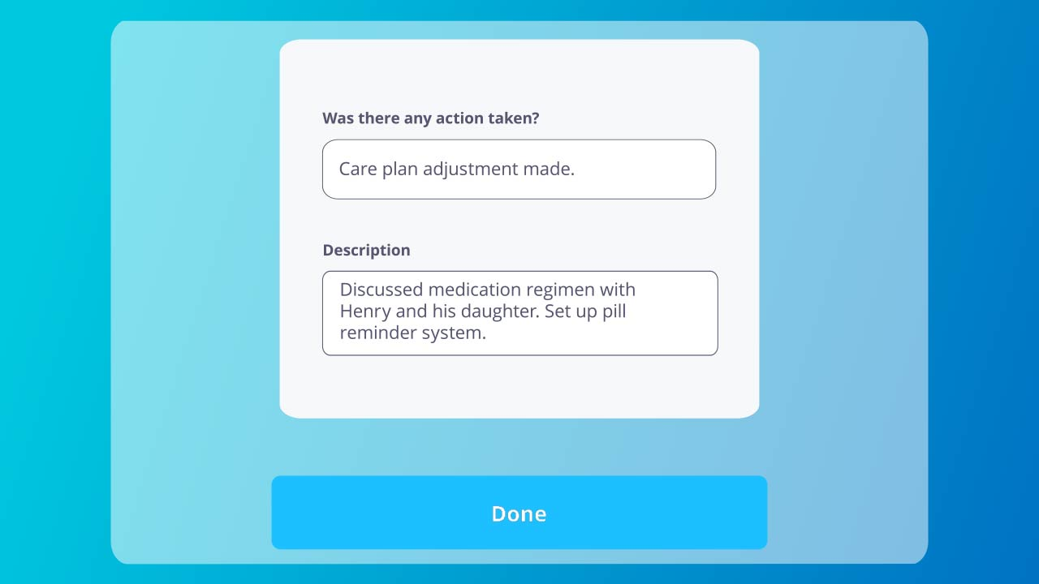
Re-Imagined Medication Management
Follow-up Care Just Got Easier to Assist with Adherence and Side Effects
Effective medication management catching suspected errors early on

Slide 10



Staying Ahead with Proactive Care
Detect
Predict
Prevent

Slide 11
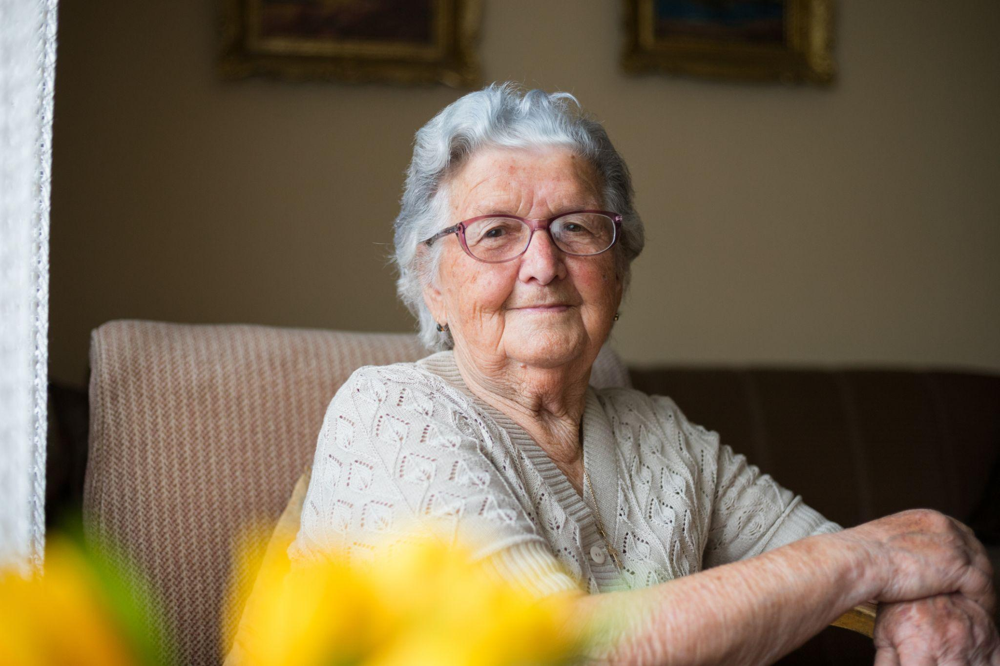
A Senior Client Story
Sensi Comes to the Rescue for Diana
Diana had severe dementia, family only approved 9 hours of care despite 24/7 need
In first 30 days, she fell 3 times and was hospitalized due to unmet night needs
With Sensi, the issue was identified - she woke up screaming for 1 hr before caregiver arrived
Care plan was optimized by adding morning hours, no more falls/hospitalizations for 14 months
Increased client and caregiver satisfaction scores from 0 to 100%

Slide 12


Industry Leaders Love Sensi
Join the Radical Care Movement
This technology powered by Sensi.AI can detect care-related anomalies, revolutionizing how agencies and caregivers proactively plan and provide better care.
Teepa Snow
Globally esteemed dementia educator

Slide 13
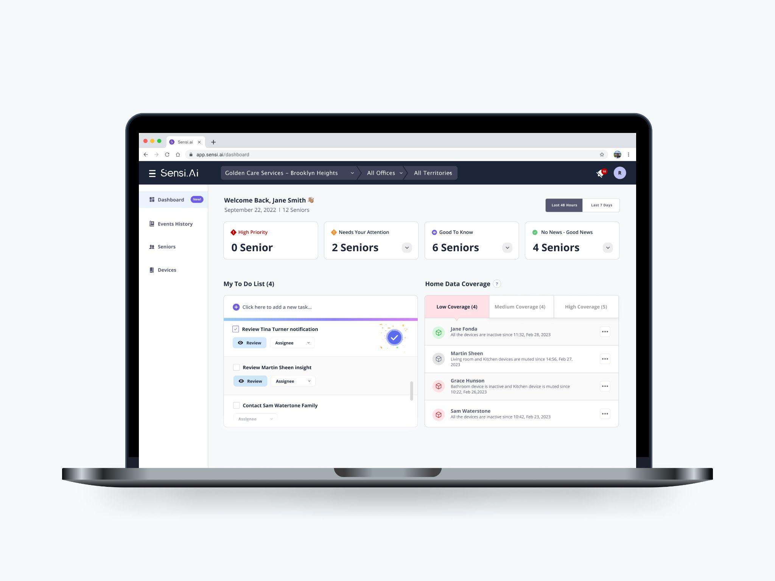
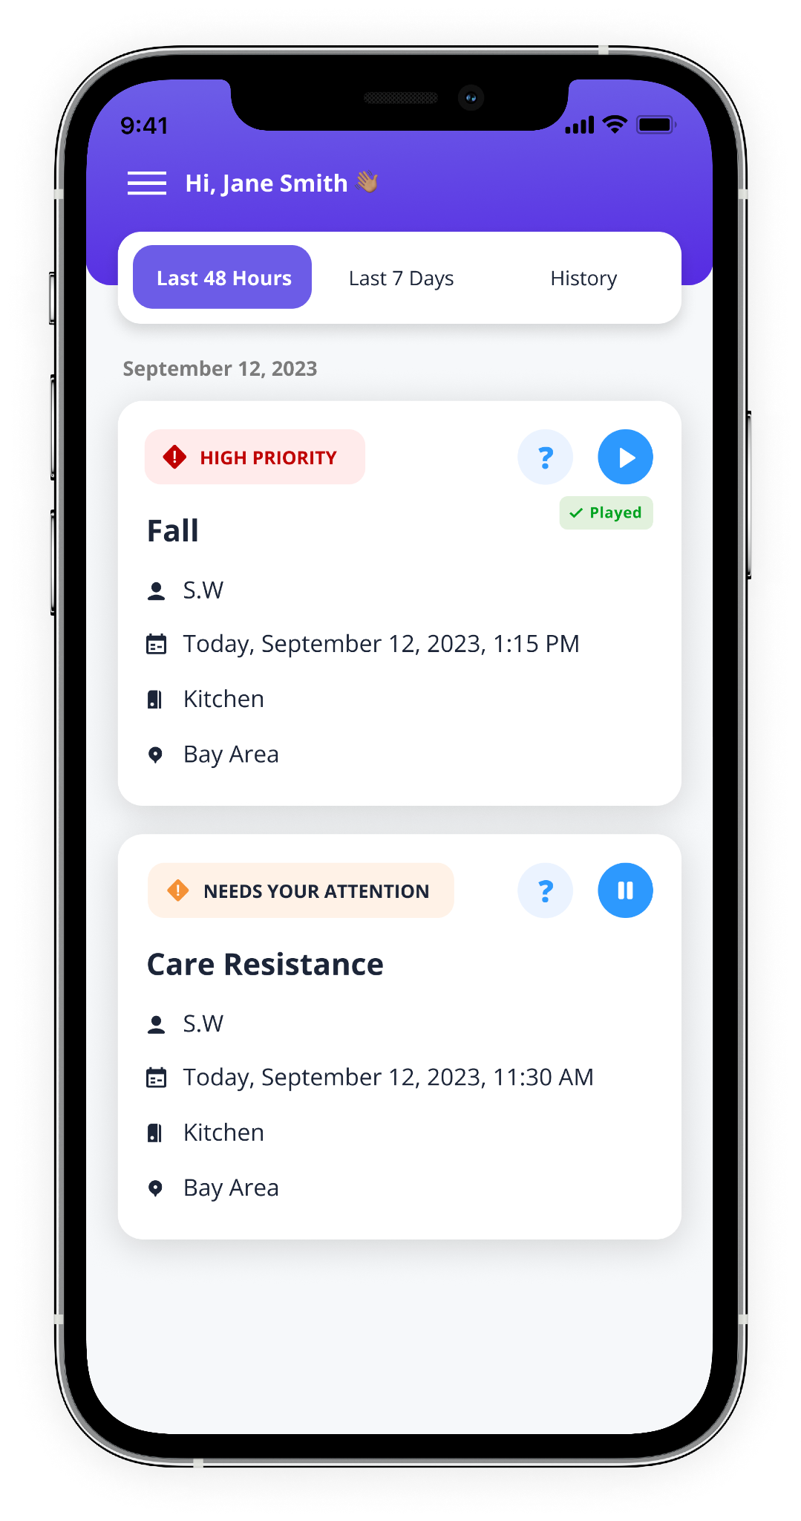
Sensi Demo

Slide 14
THANK YOU

